Slide 1
Week 5 Update
Randy & Dylan

Slide 2
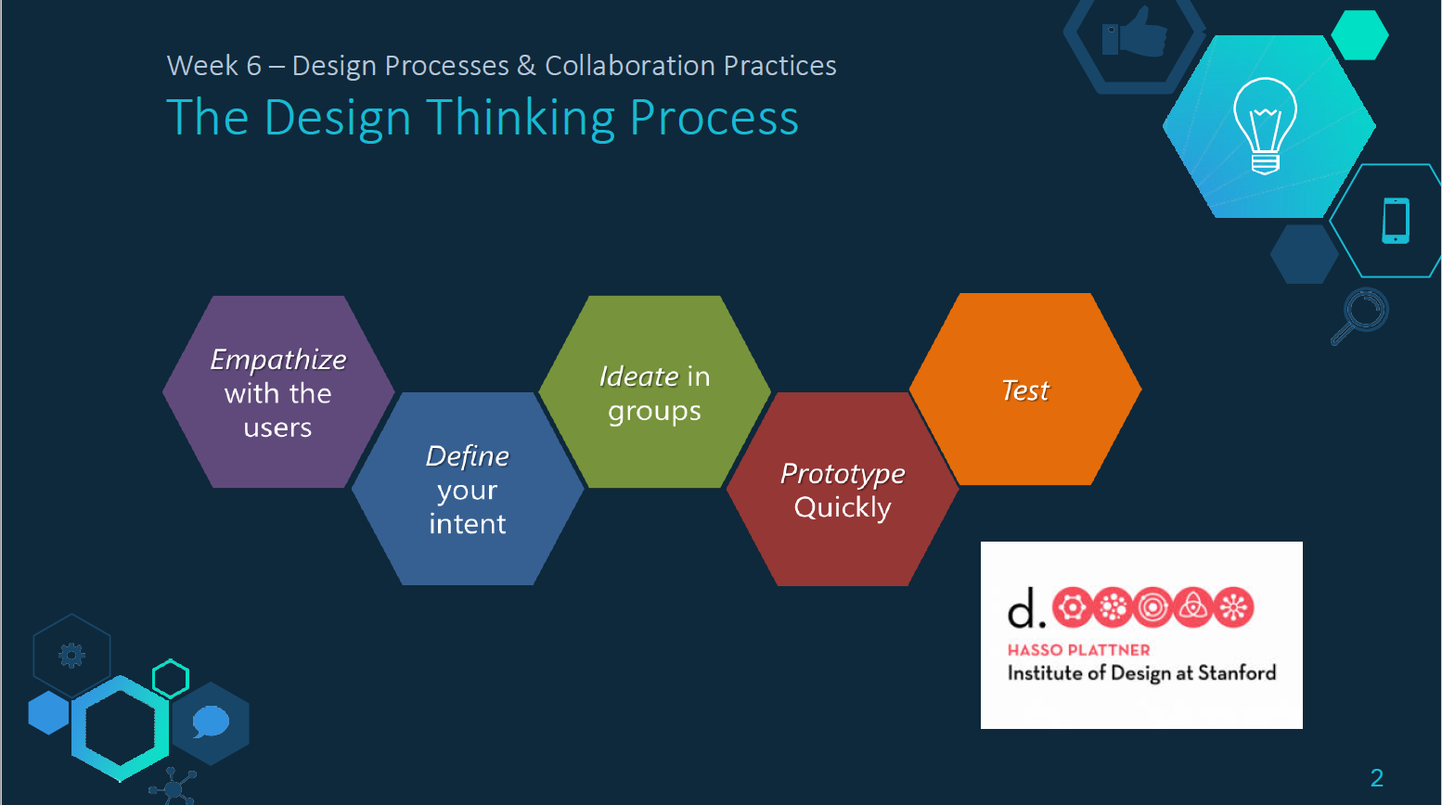
Phase 1: Empathize with the user

Slide 3
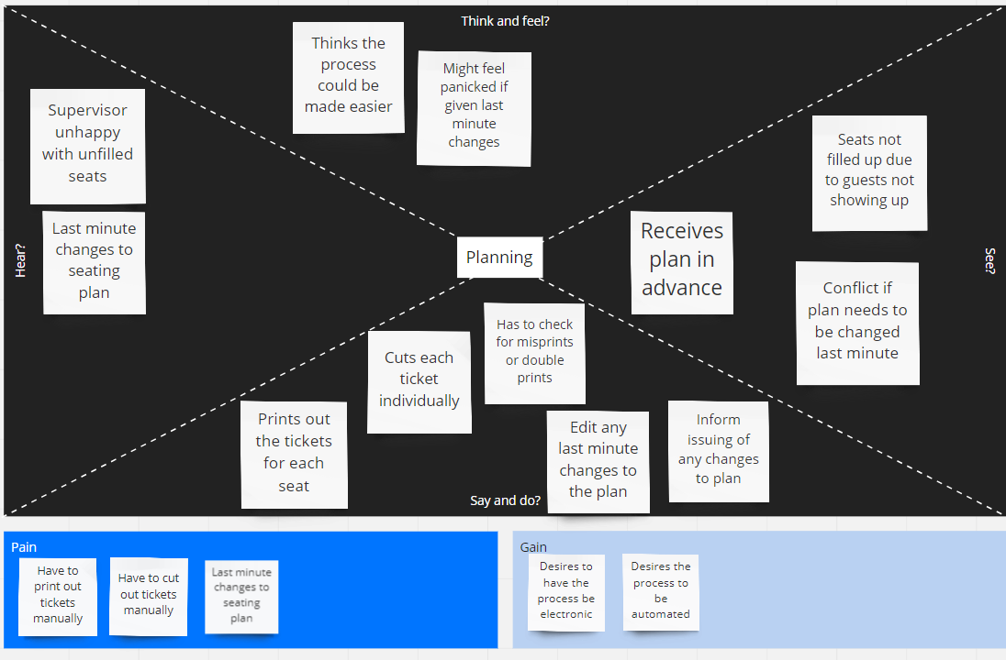
Empathy Map(Planning)

Slide 4
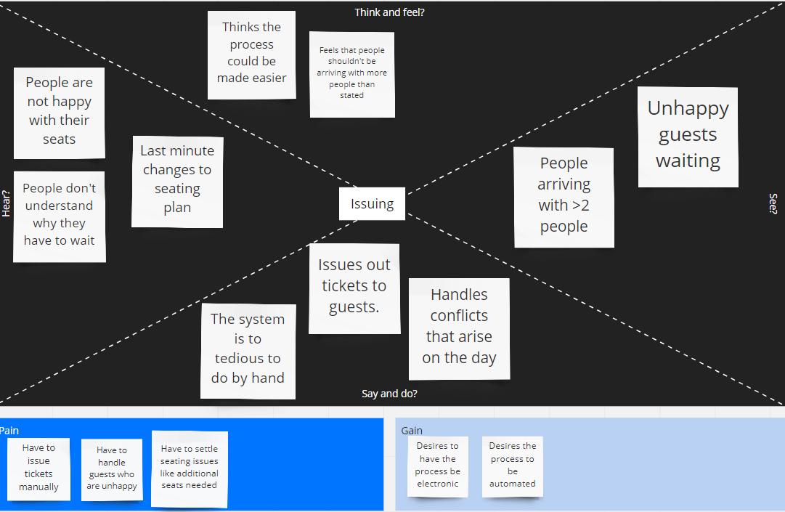
Empathy Map(Issuing)

Slide 5
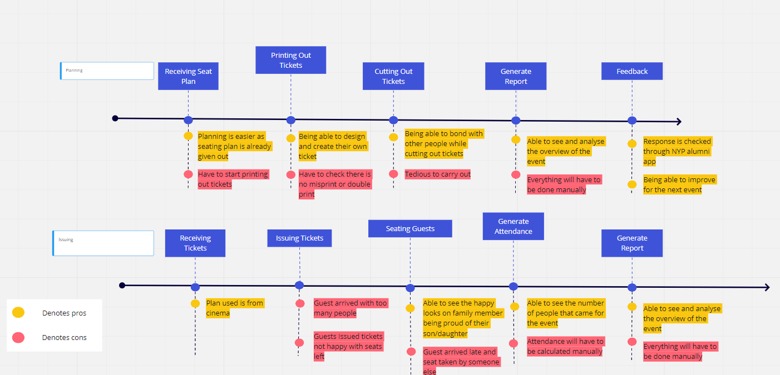
Journey Map

Slide 6
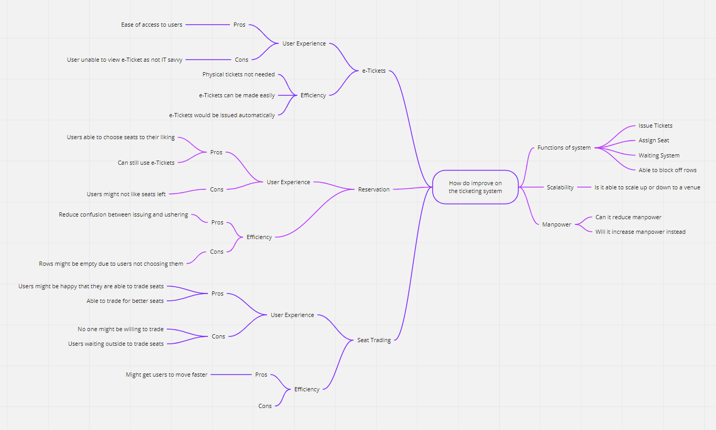
MindMap

Slide 7
Phase 2: Define your intent

Slide 8
Problem Statement
The problem with the current method of how things works are that huge amount of manpower are used to plan these events. Printing and checking of tickets are tedious and requires huge amount of time do them. Attendance taking are also done manually and sometimes there will be error. Other reports are also to be done manually and they are also tedious to do too. Since we are not only dedicating this platform to only 1 venue. We have to make it dynamic so that it will be responsive to other types of venues too. Conflicts are definitely bound to happen but the most common conflict would be guest bringing more that stated guest on the day itself.

Slide 9
How Might We
How might we help planners to ease the use of manpower?
How might we use less paper?
How might we make the planning smoother?
How might we make the platform easy to use by all ages?

Slide 10
Interview
Ms Kareen Koh (Planner)
JunJie & Sherwinn (Event Supervisor and Ticketing)
Ms Loh Moi Yong (Planner)

Slide 11
Ms Kareen Koh
In-charge of handling movie nights and entrepreneurship talk/networking talk
Entrepreneurship/Networking talk
No seating arrangement, first come first serve
Movie Nights
Start from middle to back seats
Filling up on the middle 6-8 seats, proceeding to the back row till all the middle seats are filled. Work on the seats left and right from the middle

Slide 12
Ms Kareen Koh
Alumni are involved as well for ushering and giving out tickets
Does not have any limitation/difficulties so far (have not encountered any)
Movie Theatre does include handicap seats
Does have conflicts
Customers not happy with their seats
Late customer found other people seating in their seats

Slide 13
JunJie
In-charge of attendance, ushering, supervising and handling conflicts
Common conflict
Max is only 2 people where a lot of group came in more than 2

Slide 14
Sherwinn
In-charge of issuing tickets
Process
Signup through link
Scanning QR Code on phone
Issuing tickets manually
What he does not like
Ticket are not automatic, resulting in lots of manpower used and messy

Slide 15
Sherwinn
Conflicts
Most common conflicts would be people not liking their seats as they are first come first serve
What they would like to have in the app
Waiting list for extra people

Slide 16
Ms Loh Moi Yong
In-charge of color-coding, planning seats and printing out tickets
Preparation are done months beforehand
Her difficulty would be having to cut out the tickets

Slide 17

Interview Snips (Ms Kareen Koh)
“Network gathering and Entrepreneur talk have no seating arrangement.”
“Had not encounter this issue yet. But there are handicap seats in the movie theatre.”

Slide 18
Interview Snips (Ms Kareen Koh)
“It is flexible in a sense that i can note in any seating arrangement depending on what the cinema give me”
Pain point is more on double checking for payment on the AXS machine

Slide 19
Interview Snips (Ms Kareen Koh)
“For things that you may want to implement. Being able to go in and slot in the amount of rows and column”
People being late and their seat being taken

Slide 20
Interview Snips (Junjie)
People coming in with more than 2 guests
“For those extra families that come, they have to write down their name and everything. I think you can continue to implement this”

Slide 21
Interview Snips (Junjie)
“It is okay if you guys do reserve?”
We have explained to him why we do not allow reserve but this is a function that can be kept if we want to use in the future
Details on why he think reserve would be good.

Slide 22
Interview Snips (Sherwinn)
“Giving of tickets is not automatic but manually. We need quite a lot of manpower. A little bit messy”
“Seatings will be in the QR code. Put up a waiting list for extra families members to go in”
“People not being happy with their seats”

Slide 23
Interview Snips (Ms Moi Loh Yong)
This is the Ms Moh talking about what she feel is the most tedious part.
“The most tedious part would be the cutting of tickets”

Slide 24
Phase 3: Ideate in Groups

Slide 25
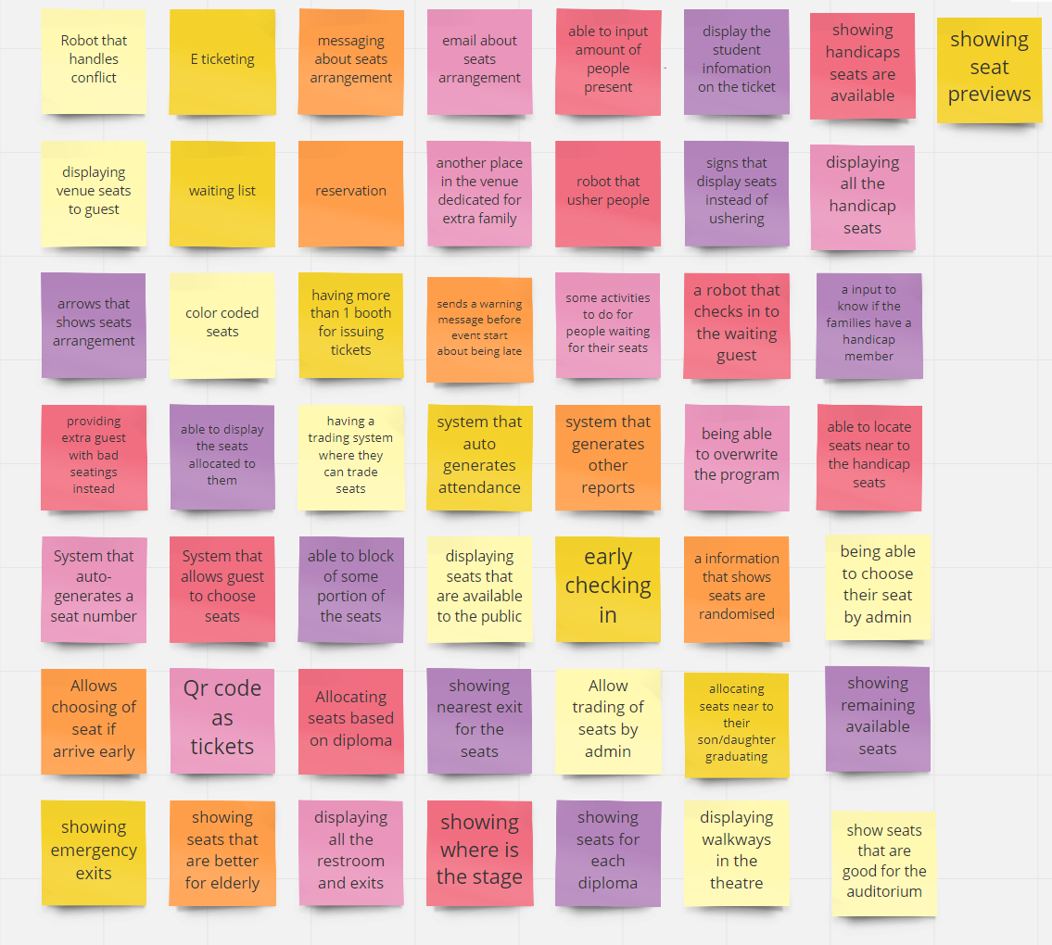
50 Ideas

Slide 26
Creative Matrix
 | Desirability | Feasibility | Viability | Novelty
e-Ticketing (9) | 3 | 2 | 3 | 1
Seat Trading(8) | 2 | 2 | 2 | 2

Slide 27
Proposed Solution
Our proposed solution would be an e-Ticketing system that would issue users tickets based on the availability of seats. It should also be easy to use and navigate for all ages.

Slide 28
Phase 4: Prototype

Slide 29
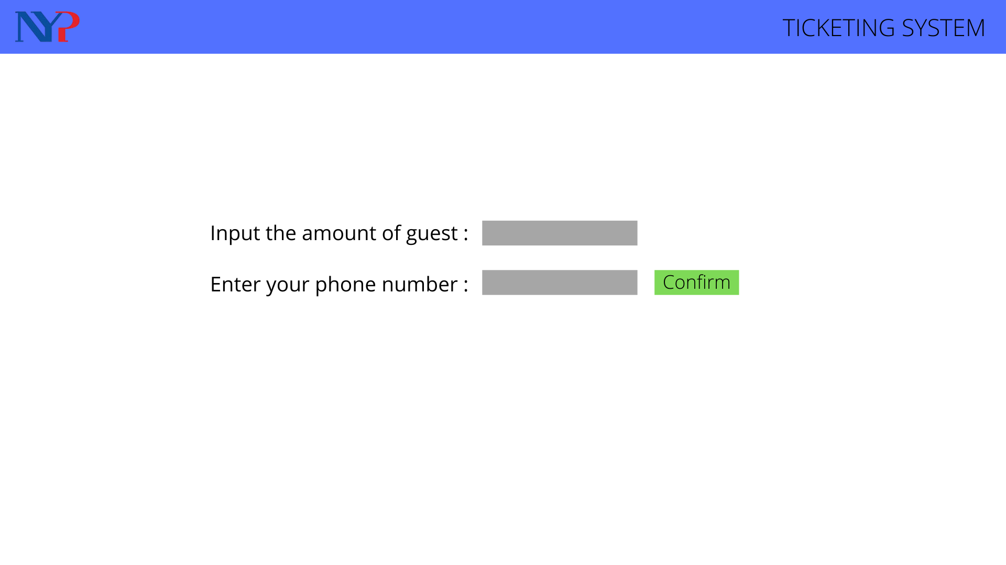
Prototype Design

Slide 30
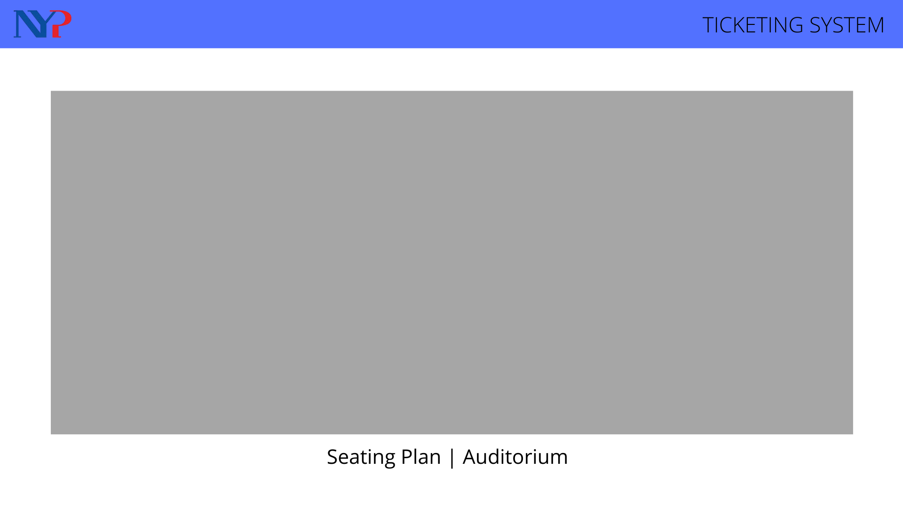
Prototype Design

Slide 31
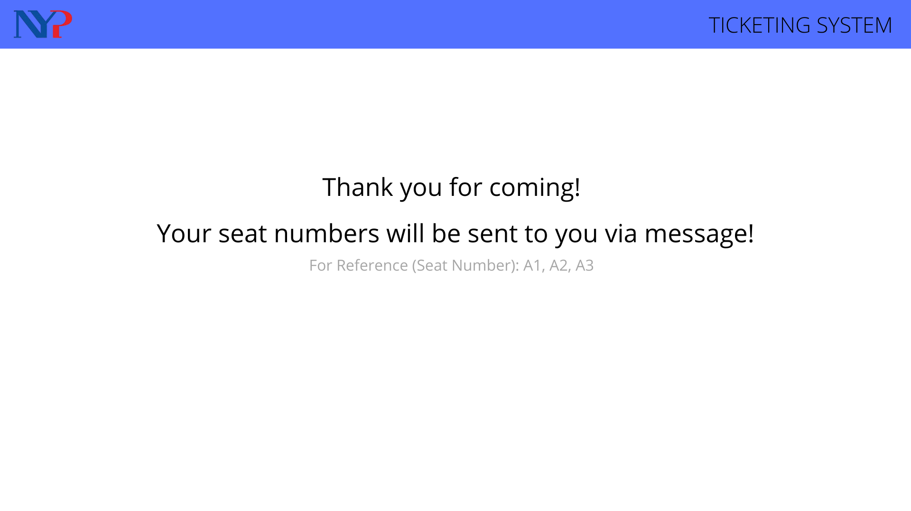
Prototype Design
Text message: Thank you for coming to the graduation ceremony!
Your assigned seats are at A1 A2 and A3

